Slide 1

Strain Gauge Monitoring
AN introduction

Slide 2
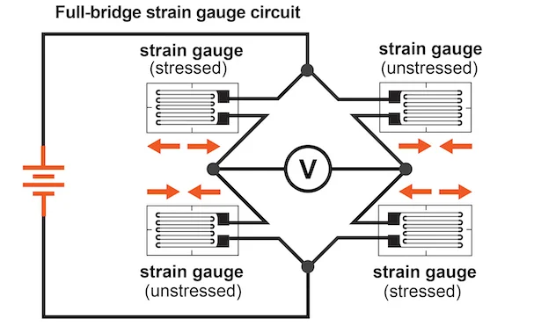
What is a Strain Gauge?
It is a Passive Transducer
It converts pressure/ force/ displacement through the gauge length changes into an electrical quantity that can be measured.

Slide 3

What is the Gauge Factor
Sensitivity of strain gauge or the Gauge Factor
the conversion factor for the Resistance to Strain.
Delta R = Change in resistance
R is original resistance
Delta L / L = Strain
$$G_{f}=\frac{∆R/R}{∆L/L}$$
https://www.youtube.com/watch?v=5p3UiEp8IOk

Slide 4
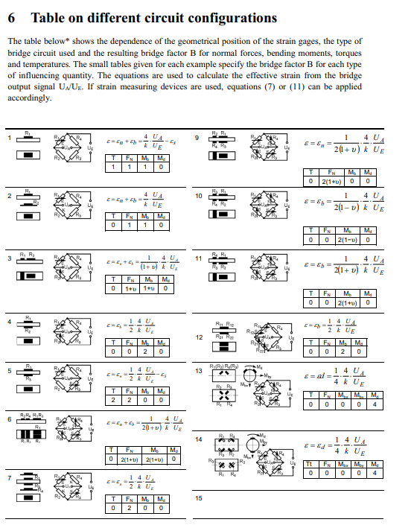
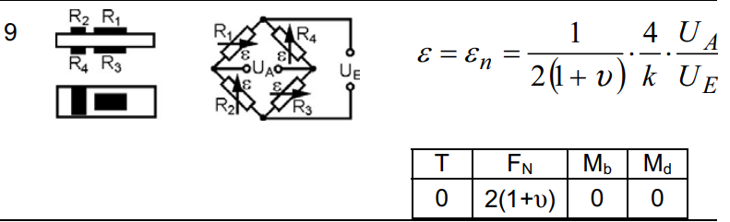
Reference Sheet HBM
Primary Reading on HBM
Gauges on the Stacker are configuration 9 (Channel 1-4)

Slide 5

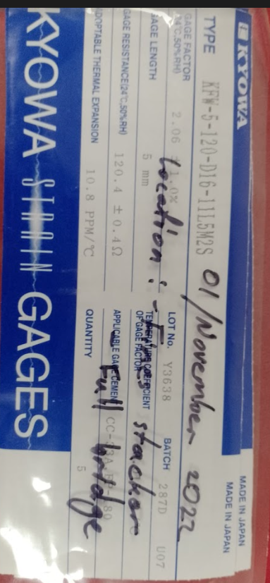
Reference Sheet HBM
Poisson Ratio is approx. 0.3
Gauge Factor = 2.06% ( For the installed CH1-4 on the Fines Stacker ) *
*Gauge Factor is written on the Packets

Slide 6
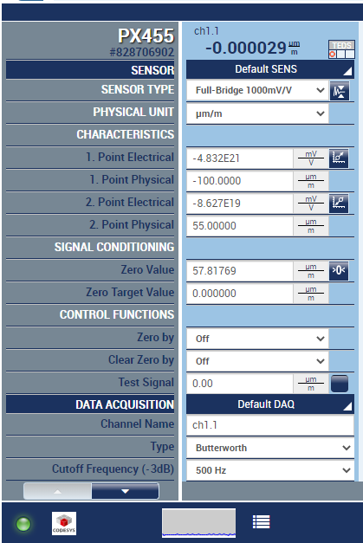
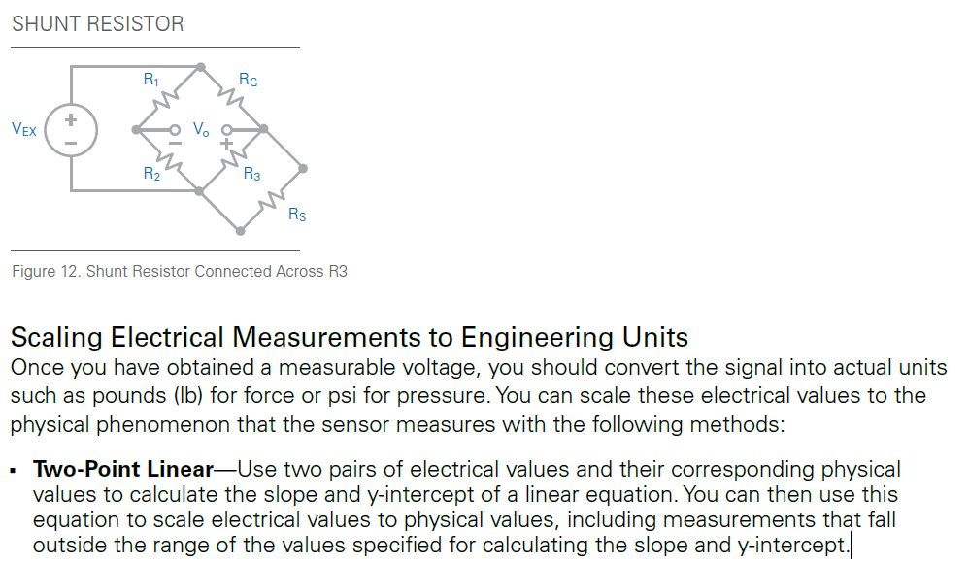
Shunt Resistor Calibration

Slide 7
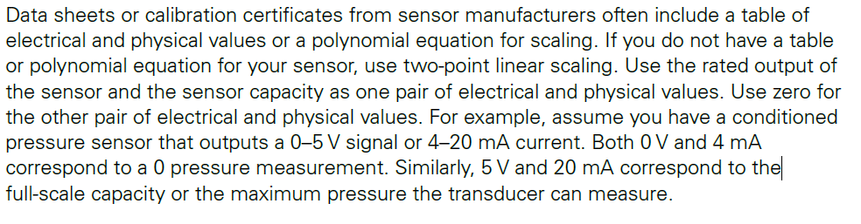
Shunt Resistor Calibration

Slide 8
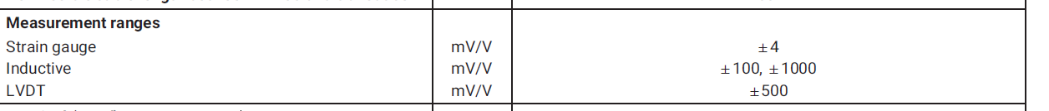
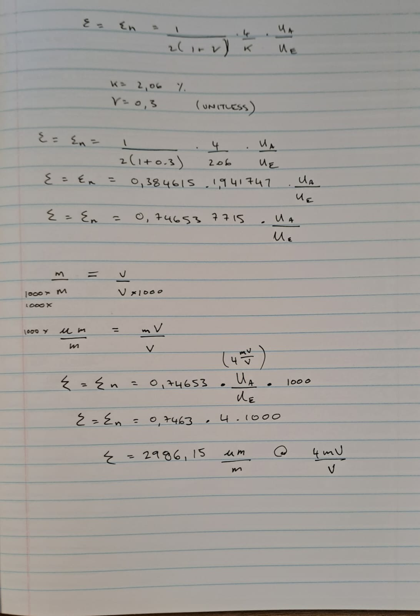
Shunt Resistor Calibration
At zero voltage , the Micro Strain should be zero.
At 4mV/V measurement we should see :

